Slide 1


Observe and Measure endpoint availability using Envoy in Virtual Appliances
Toma Petkov | linkedin.com/in/toma-petkov/
Vladimir Mihov | linkedin.com/in/realvladimirmihov/
Nikola Kaludov | kaludov.com
Notes:
How to convert a legacy monolithic system to a modern SaaS solution without losing all your clients

Slide 2
Managing a complex Virtual Appliance
What’s a Virtual appliance?
Contents of our VA
Photon OS
service A /sdk
All for one and one for all!
service C /api
Zzzzz…
service B /ls
Notes:
VA – prepackaged OVF image – lives on its own VM, but no containers inside
Interdependent services,
cascading sequences of errors
no clear availability (requirements),
no clear point of failure

Slide 3

Our mission
Make our legacy services 99.99% available
Stateless services can be 99.99% available
Legacy stateful services cannot
pod A
Envoy
pod B
Envoy
service A
state
pod C
as long as they’re elastic and load-balanced
they must survive on their own…
Notes:
The mission
Stateless services can be available all the time if they’re load-balanced correctly
Legacy stateful services cannot
They must be designed to survive
What can we do to introduce cloud-like features

Slide 4
Introduce Envoy
We have these cloud-like features…
How to observe endpoints?
service A /sdk
service C /api
Envoy
service B /ls
Notes:
Envoy as an edge-reverse proxy
Very feature rich and pluggable
All services use the same network stack (Got HTTP2/Quick for free)
LoadBalance Observability!!! Autoscales
Endpoint – a service, that’s listening on a specific internal port – The client requests a specific uri prefix
Measure availability

Slide 5

Observing Endpoints
Envoy gives us:
Access log – reduce debugging
Metrics – measure overall health

Slide 6
Traffic through Envoy
Service
Service
Traffic goes…
from downstream listeners
through routes
to upstream clusters
Envoy
Cluster
Cluster
Route
Route
Client
Listener
port 443
Notes:
Client -> Listener -> Via route -> Cluster-> Endpoints (1:1)

Slide 7

The metrics that we use
What does an upstream mean?
Envoy
Upstream
Service
Downstream
client
Upstream response metrics:
Count of 200 responses
Count of 5xx responses (server error)
Notes:
1. The upstream is the service that returns the response to the client (the downstream).
2. The metrics that we use are:
Number of 200 responses
Number of all server error responses

Slide 8
How do the metrics look like?
Envoy access log
2022-09-20T11:19:56.765Z POST /sdk HTTP/1.1 200 via_upstream
2022-09-20T11:19:56.765Z POST /ui HTTP/1.1 200 via_upstream
2022-09-20T11:19:57.903Z POST /sdk HTTP/1.1 500 via_upstream
The statistics retrieved from the admin interface
# curl --unix-socket /var/run/envoy/admin-pipe localhost/stats?format=prometheus
envoy_cluster_upstream_rq_total{envoy_cluster_name="/sdk"} 593
envoy_cluster_upstream_rq{envoy_response_code="200",envoy_cluster_name="/sdk"} 479 envoy_cluster_upstream_rq_xx{envoy_response_code_class="5",envoy_cluster_name="/sdk"} 112
Notes:
The access log is a log of all of the requests that Envoy proxied.
It’s very verbose and it helps when debugging.
When observing the state of the system we need much less information that’s aggregated from the access log.

Slide 9
Envoy admin interface configuration
config.yaml
admin:
address:
pipe:
path: /var/run/envoy/admin-pipe
mode: 0706
👈Anyone can read and write
/usr/lib/tmpfiles.d/envoy.conf (See man 5 tmpfiles.d)
# Unix socket directory for Envoy
d /var/run/envoy 0700 envoy envoy - -
a /var/run/envoy - - - - u:metrics:x
👇The metrics user can enter /var/run/envoy
Notes:
The admin pipe is on a UDS, because Envoy’s admin interface does not support authentication. We secure it with file system permissions.

Slide 10
Envoy statistics configuration
config.yaml
stats_config:
stats_matcher:
inclusion_list:
patterns:
- safe_regex:
regex: cluster.*upstream_rq_.*
Notes:
If all statistics are enabled (and they are by default), the memory consumption can go up with about 50 MB. This configuration limits the statistics to the ones we need.

Slide 11
How do we get the metrics to the cloud?
Virtual Appliance
Envoy
Metric Sink
Service
Cloud Push
Service
Wavefront
Wavefront
Proxy
Notes:
Overall architecture:
Virtual appliance with Envoy as a front proxy
Metric sink service: receives the statistics from envoy
Cloud push service: Formats the statistics for different monitoring solutions. We mostly use Wavefront.
Wavefront proxy and Wavefront

Slide 12
We have the data. How do we use it?
We use them to…
track regressions (like performance or code coverage metrics)
measure improvements
make sure we’re meeting SLA
How do we get this graph?
Notes:
Back to the problem from the beginning
The graph
We run heavy long-running tests to measure performance.
The same tests can be used to measure availability.
What uses do we get from availability metrics?
Track regressions
If the overall availability falls below a baseline, we have to investigate.
Measure improvements
Those same tests, run regularly, can give us a trend graph.
We can compare availability before and after a feature that is supposed to increase availability
Make sure we’re meeting SLA
SaaS implies we’re giving our customers promises about our service
We must know whether we’re keeping them
We must never ship a new version if we aren’t

Slide 13
Our approach: internal
A long-running at-scale test
time
Notes:
We have 2 different approaches – one internal and another for clients / SREs
In the former category, we’re interested in aggregating availability data over an entire at-scale run
This could go on for hours
We opt for a heuristic approach
Based entirely on Envoy’s historic data (no pings), to not interfere with the authenticity of the run
Split the data into evenly timed chunks

Slide 14
Our approach: internal
A long-running at-scale test
time
100%
80%
71%
100%
75%
66%
100%
75%
100%
100%
100%
75%
Notes:
Split that way, we can look at the worst regions
We don’t care about the actual numbers; we’re only looking for the worst offenders
Regions with no data we don’t care about, so we assign them a full score

Slide 15
Our approach: internal
A long-running at-scale test
time
100%
80%
71%
100%
75%
66%
100%
75%
100%
100%
100%
75%
Final availability score 68.5%
Perfect regions
50%
Notes:
The overall availability score is calculated by taking the worst 20% of regions and averaging their score
We take this number as the final score because we want our worst-case to cover our agreement
There’s a second score we keep track of, which is the percentage of “perfect regions”
These scores are both tracked between runs
In case of major regressions, the worst offender regions are examined through logs to figure out what happened

Slide 16
What is “current” availability?
How available is our system at this moment?
2022-09-20T11:19:56 POST /sdk HTTP/1.1 200 via_upstream
2022-09-20T11:19:57 POST /sdk HTTP/1.1 200 via_upstream
2022-09-20T11:19:58 POST /sdk HTTP/1.1 500 via_upstream
2022-09-20T11:19:59 POST /sdk HTTP/1.1 200 via_upstream
2022-09-20T11:20:00 POST /sdk HTTP/1.1 200 via_upstream
2022-09-20T11:20:01 POST /sdk HTTP/1.1 200 via_upstream
2022-09-20T11:20:02 POST /sdk HTTP/1.1 500 via_upstream
2022-09-20T11:20:03 POST /sdk HTTP/1.1 500 via_upstream
2022-09-20T11:20:04 POST /sdk HTTP/1.1 500 via_upstream
2022-09-20T11:20:05 POST /sdk HTTP/1.1 500 via_upstream
50%
When is “at this moment”?
Last 10 seconds → 50% availability

Slide 17
What is “current” availability?
How available is our system at this moment?
2022-09-20T11:19:56 POST /sdk HTTP/1.1 200 via_upstream
2022-09-20T11:19:57 POST /sdk HTTP/1.1 200 via_upstream
2022-09-20T11:19:58 POST /sdk HTTP/1.1 500 via_upstream
2022-09-20T11:19:59 POST /sdk HTTP/1.1 200 via_upstream
2022-09-20T11:20:00 POST /sdk HTTP/1.1 200 via_upstream
2022-09-20T11:20:01 POST /sdk HTTP/1.1 200 via_upstream
2022-09-20T11:20:02 POST /sdk HTTP/1.1 500 via_upstream
2022-09-20T11:20:03 POST /sdk HTTP/1.1 500 via_upstream
2022-09-20T11:20:04 POST /sdk HTTP/1.1 500 via_upstream
2022-09-20T11:20:05 POST /sdk HTTP/1.1 500 via_upstream
0%
When is “at this moment”?
Last 10 seconds → 50% availability
Last 3 seconds → 0% availability

Slide 18

What is “current” availability?
If a tree falls in a forest and no one is around to hear it, does it make a sound?
What is our service’s availability when nobody is using it?
100% available?
0% available?
undefined?
Notes:
Another downside of getting all availability measurements from historical data is that sometimes there isn’t enough data
In an edge case, what number should we display as “current availability” when there haven’t been any requests recently?
100% available?
0% available?
undefined?

Slide 19

What is “current” availability?
A bit easier:
What is our service’s availability when there’s only been 1 request recently?
Hint: You’ve encountered this problem before
Notes:
An easier version of this question is the following:
What is our service’s availability when there has only been 1 request recently and it failed?
But this is a problem that we’re all familiar with
Do you see it now?

Slide 20
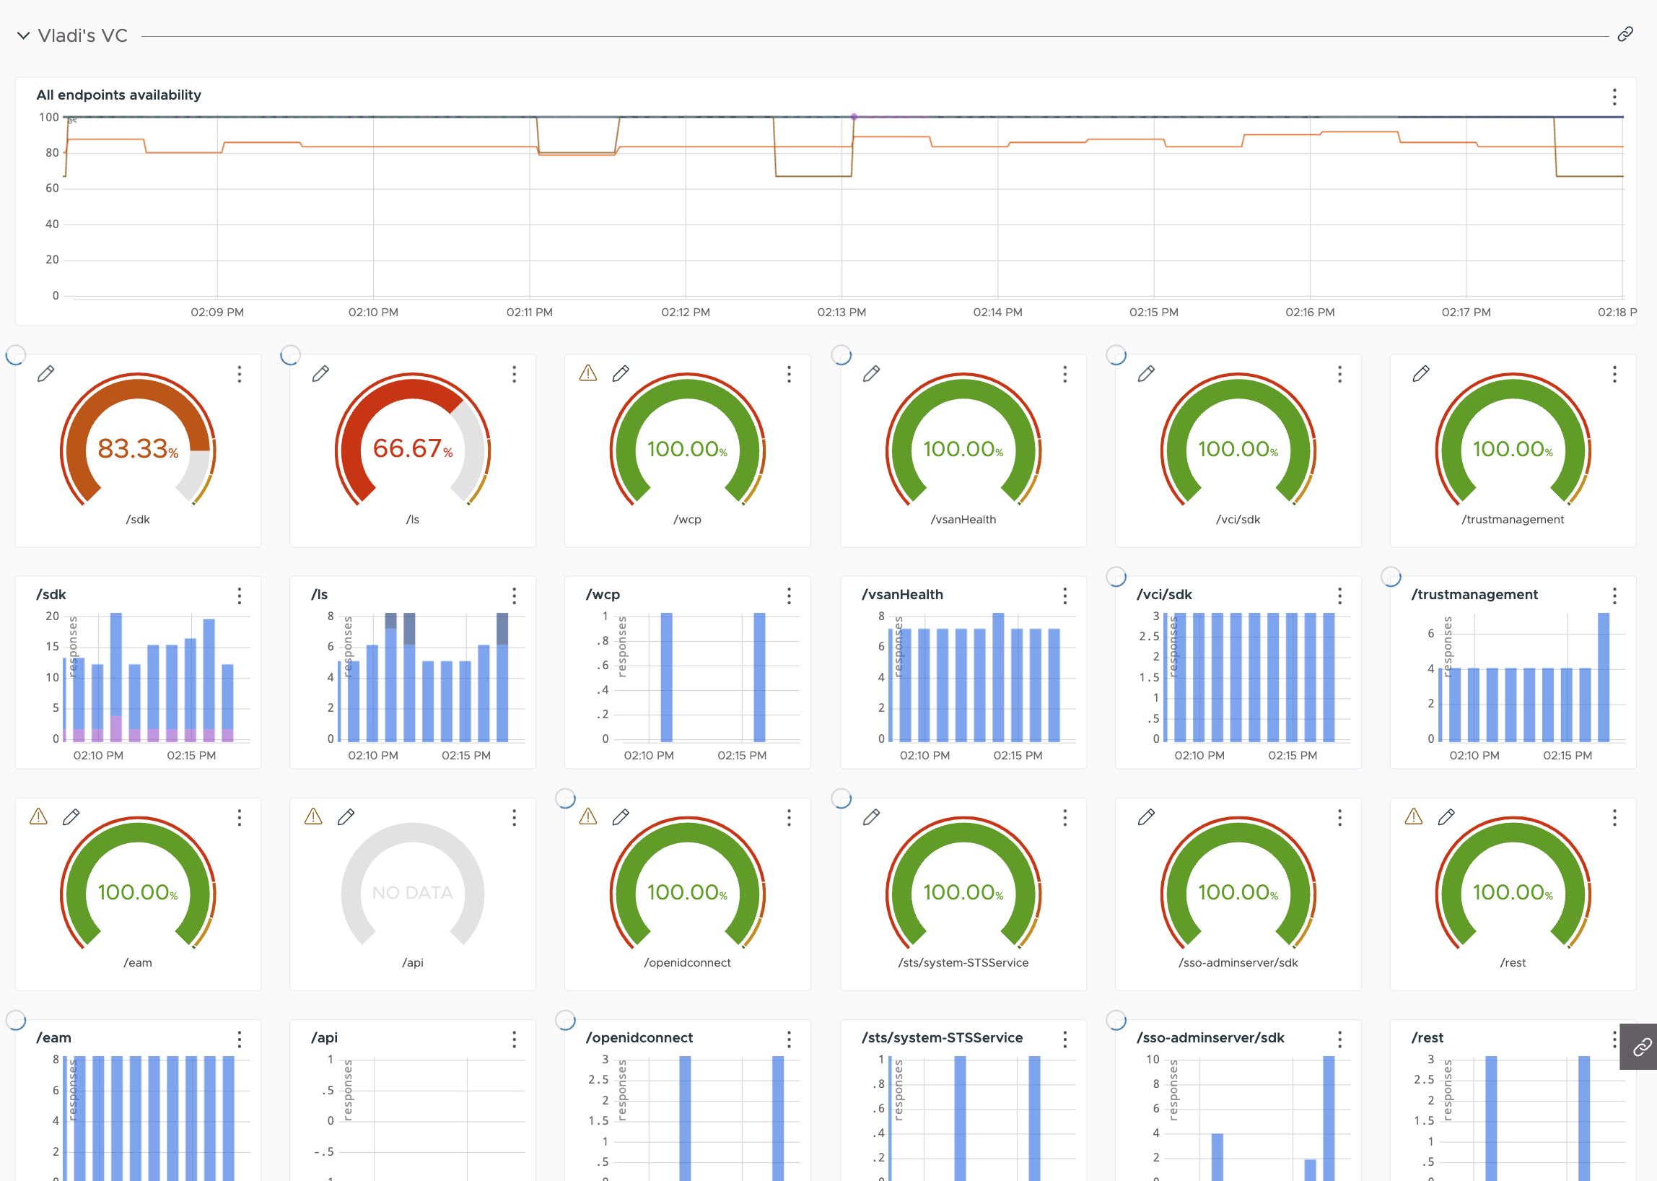
Our approach: For clients and SREs
At-the-moment aggregation approaches:
Average the last X responses Quite bad
Average over last X seconds We need to also supply sample size
Notes:
For SREs (and clients sometimes) we take a completely different approach
We give them a dashboard with summarized information about the “at-the-moment” availability for each endpoint
For aggregating the “at-the-moment” data there are a few viable approaches we’ve found:
Averaging the last X responses
Simple, but updates slowly to sudden changes
Average over last X seconds
Better, but we need to show the sample size the data is based on
Suffers from the “Amazon ratings” problem
5 stars average from 10 reviewers is less assuring than 4.7 stars from 1000 reviewers
Weighted average over last X responses
Each response is weighted reversely proportional to the time since it happened
Will try implementing it next
Bayesian updating
Much too complex
Probabilities of probabilities
Involves ideas from measure theory

Slide 21
Our approach: For clients and SREs
Endpoint /ls
At-the-moment aggregation approaches:
Average the last X responses Quite bad
Average over last X seconds We need to also supply sample size
Notes:
For SREs (and clients sometimes) we take a completely different approach
We give them a dashboard with summarized information about the “at-the-moment” availability for each endpoint
For aggregating the “at-the-moment” data there are a few viable approaches we’ve found:
Averaging the last X responses
Simple, but updates slowly to sudden changes
Average over last X seconds
Better, but we need to show the sample size the data is based on
Suffers from the “Amazon ratings” problem
5 stars average from 10 reviewers is less assuring than 4.7 stars from 1000 reviewers
Weighted average over last X responses
Each response is weighted reversely proportional to the time since it happened
Will try implementing it next
Bayesian updating
Much too complex
Probabilities of probabilities
Involves ideas from measure theory

Slide 22


Our approach: For clients and SREs
At-the-moment aggregation approaches:
Average the last X responses Quite bad
Average over last X seconds We need to also supply sample size
Weighted average over last X responses Best that I’ve tested
Bayesian updating Very complex, will not get into it
3blue1brown
probabilities of probabilities
Notes:
For SREs (and clients sometimes) we take a completely different approach
We give them a dashboard with summarized information about the “at-the-moment” availability for each endpoint
For aggregating the “at-the-moment” data there are a few viable approaches we’ve found:
Averaging the last X responses
Simple, but updates slowly to sudden changes
Average over last X seconds
Better, but we need to show the sample size the data is based on
Suffers from the “Amazon ratings” problem
5 stars average from 10 reviewers is less assuring than 4.7 stars from 1000 reviewers
Weighted average over last X responses
Each response is weighted reversely proportional to the time since it happened
Will try implementing it next
Bayesian updating
Much too complex
Probabilities of probabilities
Involves ideas from measure theory
Check out 3blue1brown’s videos on probabilities of probabilities on YouTube

Slide 23

Q&A
Thanks for coming! Questions are welcome on:
Toma Petkov | linkedin.com/in/toma-petkov/
Vladimir Mihov | linkedin.com/in/realvladimirmihov/
Nikola Kaludov | kaludov.com

